Slide 1
Spiritual formation of student-athletes
Hayley Richardson

Slide 2
Surveys
National
NSSE, BCSSE
TFS, YFCY
Point Loma
HG
Notes:
National Survey of Student Engagement, Beginning College Survey of Student Engagement, The Freshman Survey, Your First College Year, Homegrown

Slide 3
Categories for All Survey Questions
Roughly 1000 questions
Originally 97 categories down to 15
Many questions are similar, but with different wording
Similar Surveys
NSSE & BCSSE
TFS & YFCY
TFS 2010, 2011, 2012
Indicate the importance to you personally of: Becoming an authority in my field
Indicate the importance to you personally of each of the following: Becoming an authority in my field
YFCY 2012, 2013

Slide 4
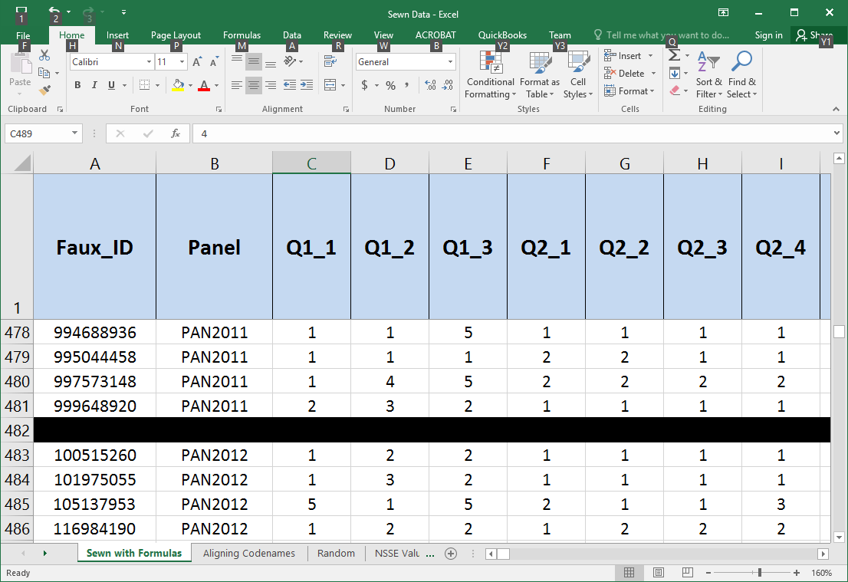
Sewing Data Together
Put together all data for HG surveys
Arranged by panel and class standing

Slide 5
Sewing Data Together (Continued)
Renumbered the HG codenames so that the freshman survey matched all of the other surveys
Used VLOOKUP() to get data
Sewed NSSE data together

Slide 6
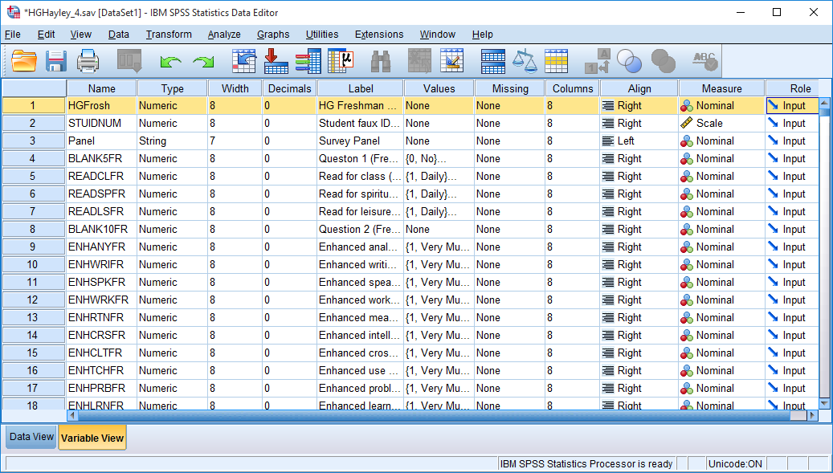
SPSS
Made new codenames for HG and NSSE questions to get them ready for SPSS
Example: Q4_4->PREVNGSE (Prior joined in local evangelism (Senior))
Input all data from HG and NSSE surveys into SPSS

Slide 7
Fixing Errors
0’s in place of .’s in HG
NSSE codename duplicates
Matching up ID numbers across HG and NSSE data
Re-added the HG and NSSE data into SPSS
Ran frequencies->more errors
Incorrect values needed to be marked as such

Slide 8
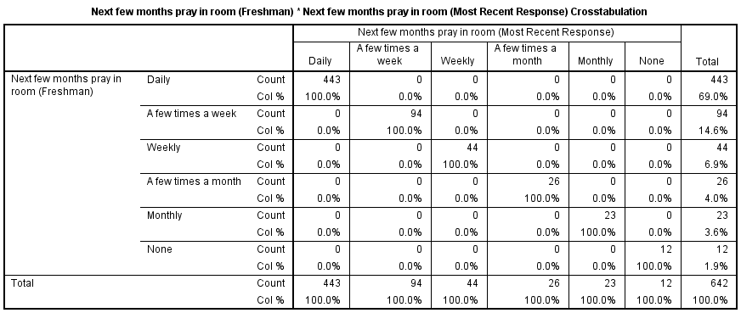
Crosstabulations
HG
Row: Freshman
Column: Most Recent Response

Slide 9
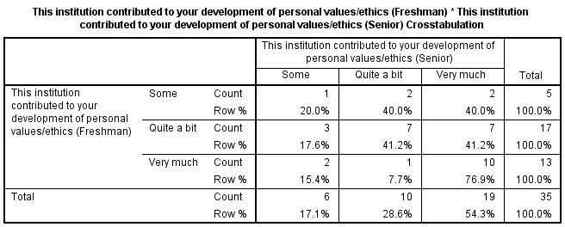
Crosstabulations (Continued)
NSSE
Row: Freshman
Column: Senior

Slide 10
Preparation for Honors Project
How College Affects Students
Spiritual Formation in Emerging Adulthood
Emerging Adulthood and Faith
Spiritual formation of the student-athlete population at PLNU
How student-athletes change or grow in faith during time at PLNU
Compare the student-athlete population with rest of student body
Hypotheses
May not be as much of a faith component in the student-athletes
More room for growth and change

Slide 11
Data Collection
List of all ID numbers sent to Jackie Armstrong
Returned with answers to the following questions:
Was the student ever an athlete at Point Loma?
Was the student ever on a PLNU athletic scholarship?
Out of 997 students, only 49 were student-athletes
More data needed

Slide 12
Athlete Survey
Gather data from students who will be athletes this coming school year
Took questions out of HG Survey that had to do with spiritual formation
Made a one-page smaller survey
Given to all Student-Athletes for this year
Ran crosstabs on non-student-athletes
Next Steps
Enter all data into Excel -> SPSS
Run significance tests to see whether differences are substantial

